Slide 1
Forest Cover Analysis
-Madhavi rao

Slide 2
Introduction-Problem Statement
The study area includes four wilderness areas located in the Roosevelt National Forest of northern Colorado. Each observation is a 30m x 30m patch. You are asked to predict an integer classification for the forest cover type. The seven types are:
1 - Spruce/Fir 2 - Lodgepole Pine 3 - Ponderosa Pine 4 - Cottonwood/Willow 5 - Aspen 6 - Douglas-fir 7 - Krummholz

Slide 3
Exploratory Data Analysis

Slide 4
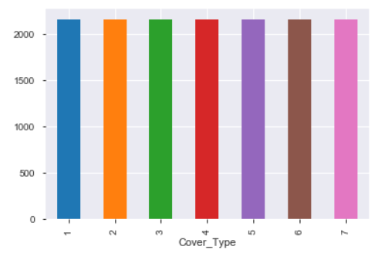
Distribution of Forest Cover Type
All the seven Forest Cover Types have equal representation.

Slide 5
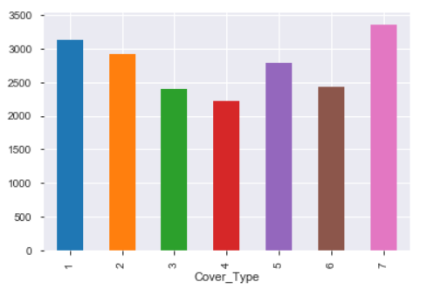
Cover Type and Elevation
Krummholz forests have the highest elevation and Cottonwood/Willow forests have the lowest elevation

Slide 6
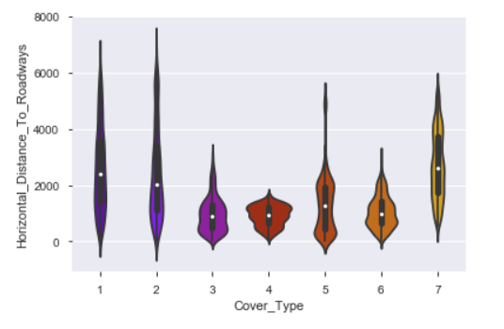
Cover Type and Horizontal Distance to Roadways
Lodgepole Pine forests have the longest horizontal distance from roads and Cottonwood/Willow forests have the lowest.

Slide 7
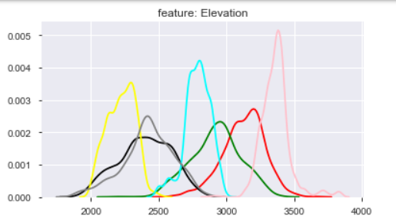
Distribution graphs
Elevation has better distinction of cover types in the distribution graph. This is an important feature for analysis and prediction
Krummholz Cover type has the highest elevation and Cottonwood/Willow cover type has the lowest elevation.

Slide 8
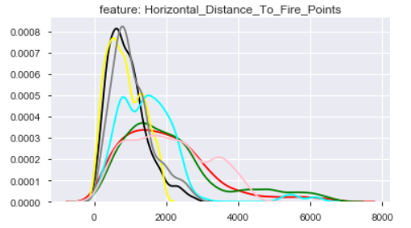
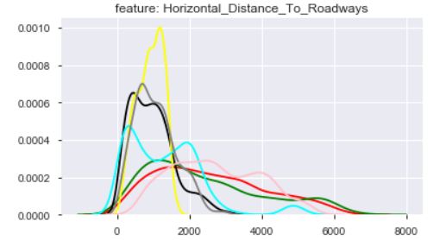
Distributions:
Both these graphs have similar distribution for the cover types.
We could make a inference with some confidence that the roadways could be one interesting source for fire to be triggered.

Slide 9
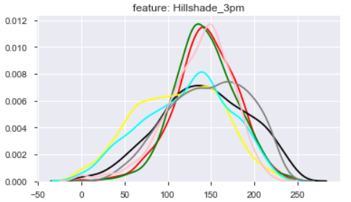
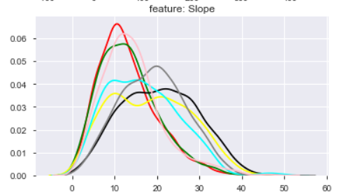
Hill Shade at 3pm has a fairly normal distribution.
Slope distribution is skewed to its left.

Slide 10
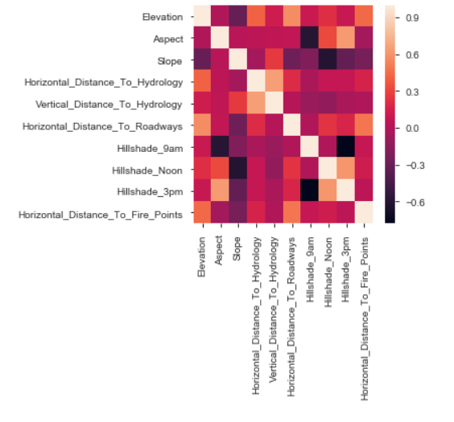
Correlations

Slide 11
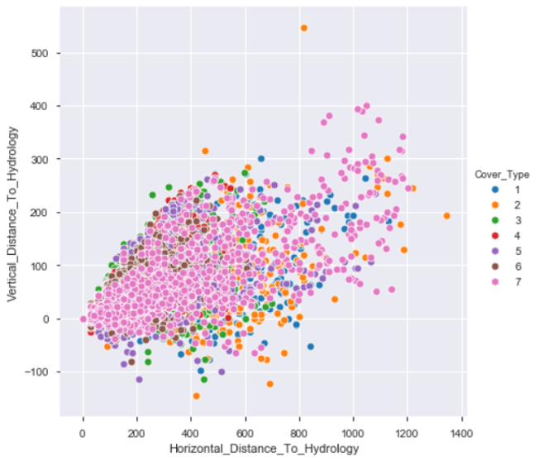
Pairwise relationships
Vertical distance and horizontal distance to hydrology form a liner correlation with each other.

Slide 12
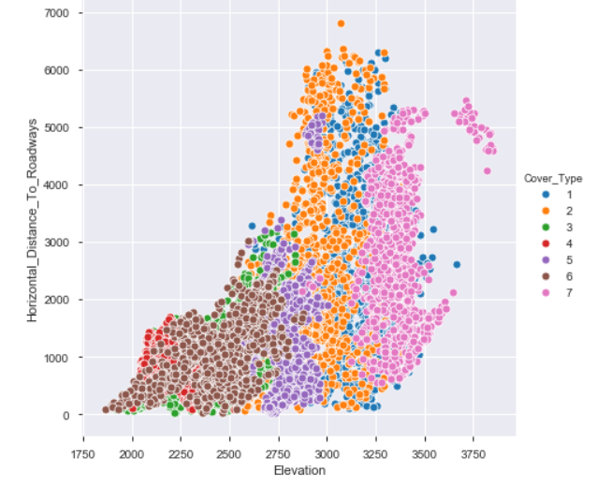
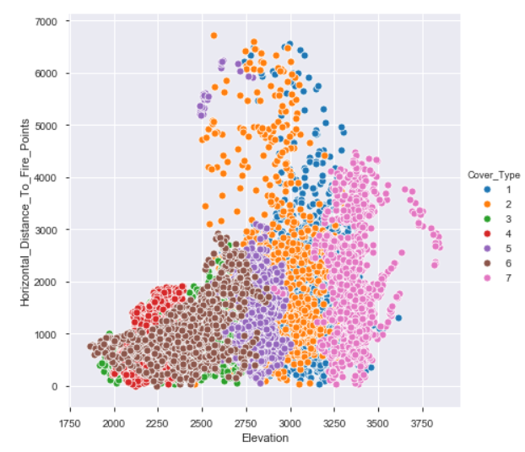

Slide 13
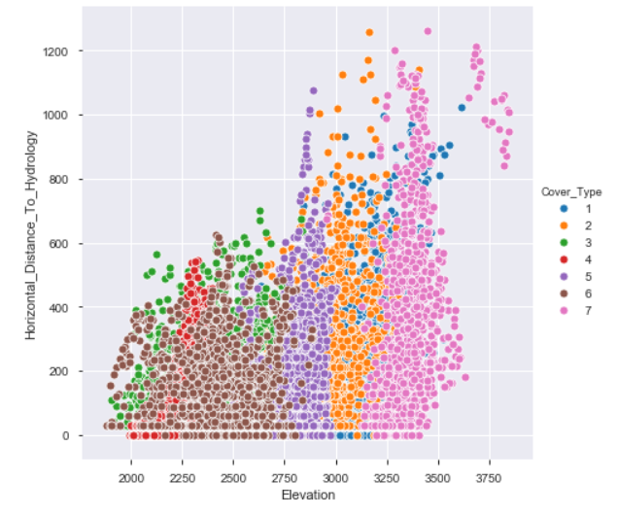
horizontal distance to roadways ,horizontal distance to fire points and horizontal distance to hydrology form patterns which can distinguish Cover type classes with each other.

Slide 14
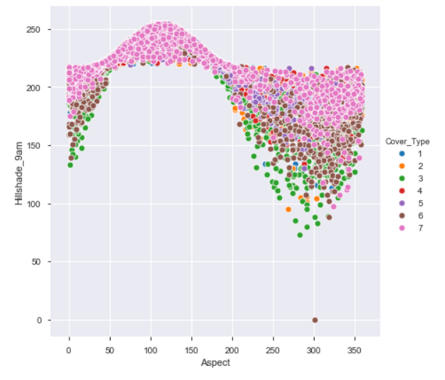
Hillshade at 9am is high at lower ranges of Aspect ratio and low at higher ranges of Aspect.

Slide 15
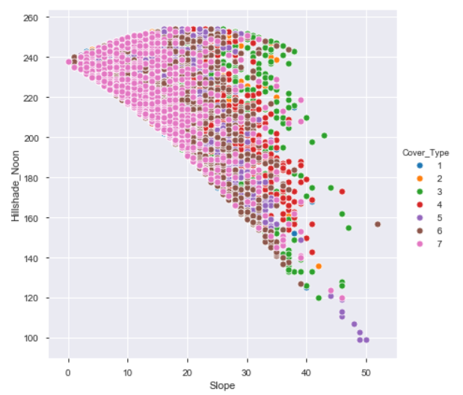
Hillshade at noon is decreasing with Slope as a overall trend.

Slide 16
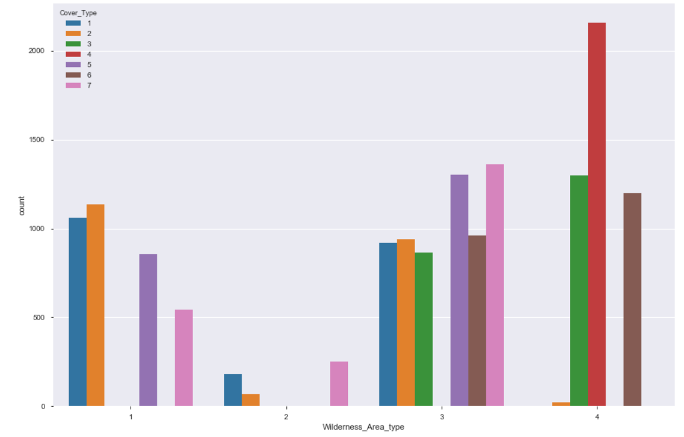
Distribution of Wilderness Area types and Cover Type
Wilderness area type 3 covers almost all the forest cover types excepting cover 4.
Wilderness area type 2 has very less representation of forest covers.
Cover Type 4 is found only in the Wilderness type 4. So wilderness type 4 can provide higher distinction to cover 4 .

Slide 17
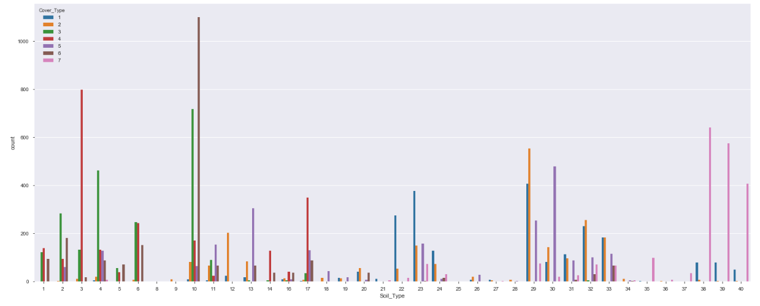
Distribution of Soil types and Cover Type
Soil Type 4,10,11 can be considered as most versatile as most varieties of forest covers can be seen growing in them.
Some of the Soil types have higher representation of certain cover types which makes good classifier, like :-
Soil Type 1-3(cover type 4) , 4-6 (Cover type 3), 10-11 (cover type 6),22-24 (cover type 1), 29-33(cover type 2), 35-40(cover type 7)

Slide 18
Model Creation and Evaluation Algorithms applied: Multinomial Logistic Regression Decision trees and hyper parameter tuning Random Forest and hyper parameter tuning K Nearest neighbors Support vector Classifier Naïve Bayes Standardization techniques applied: Min Max scaler Standard Scaler

Slide 19
Summary Post applying all the algorithms we find that post standardizing data with Standard Scaler method , Random Forest with tuning the hyper parameters scores the best score with the accuracy rate of 85 %. n_estimators = 25 min_samples_split = 2 min_samples_leaf = 1

